Slide 1
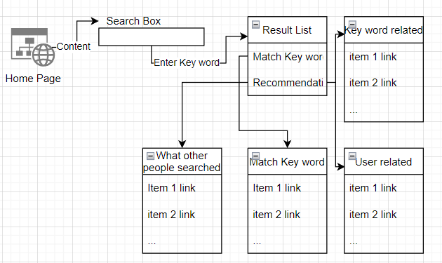
Intelligent recomment system
While user input key words in search box from Home page, and press Enter, our system will offer a list of links that point to each merchandise’s detail page. This list is generated by results of four different searchs. Direct key word search, related words search, what other people searched, and user information based search.

Slide 2
The direct key word search
The direct key word search is the simplest one, it will find the top 10 matchs from data base by using the whole key word, and then split the key word into words, do search of each, and find top 3 for each word.

Slide 3
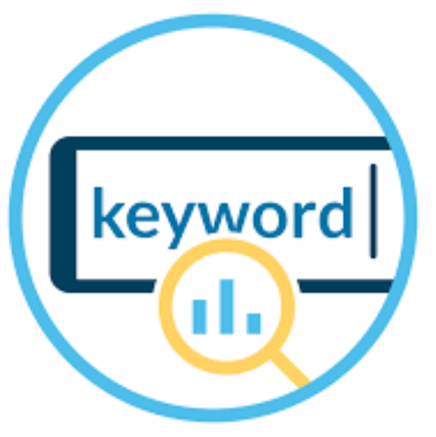
User inforamtion based search
User information based search is similar to direct key word search, but the key words this search used come from user profile.

Slide 4
User inforamtion based search
User inforamtion based search is similar to direct key word search, but the key words this search used come from user profile.

Slide 5
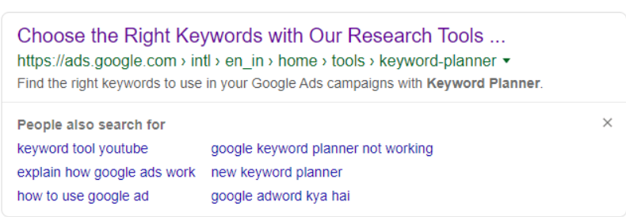
What other people searched
What other people searched is a search that tell user what’s the top 10 populer key words used by people who did the same search as user. Each user’s search history is stroed at data base related to their id. When a user did a search, the What other people searched search will select a table of all searched items from search history of all users who searched the same thing. And count the numbers of appear of each merchandise. The top 10 populer merchandises will be in the result of this search.

Slide 6
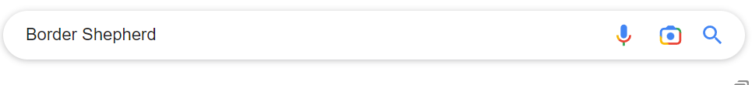
Related words search is a search
Related words search is a search that will find related words and do search for each related tags that’s been found. We will use CNN techniques to train a module that do text classification to each merchandise’s name, classification will relate the name with a tag exist or create a tag, then relate the name with the tag. While user input key word, we will use the same module to classifly which tag is related, and use the merchandises in the tag as the result.

